Slide 1
Digital portfolio
Student name: masiha begum
Register no and nmid:24134130500122008
Department: 2nd Bca(computer application)
College: deen college of arts and science and annamalai university

Slide 2
Project title
Digital portfolio

Slide 3
Adenda
Problem statement
Project overview
End users
Tools and technologies
Portfolio design layout
Results and screenshot
Conclusion
Github link

Slide 4
Problem statement
A problem statement is a clear description of the issue that needs to be addressed. It explains the gap between the current situation and the desired outcome

Slide 5
Who are the end users
An end user is the person who ultimately uses a product, service, or system.
They are the final consumers in the chain of product development and delivery.
End users may not be the people who purchase, install, or maintain the system, but they are the ones who actually interact with and benefit from it

Slide 6
Tools and techniques
🔧 Tools
These are instruments, software, or applications used to complete a task. Examples:
Software Development → VS Code, Git, Eclipse
Project Management → MS Project, Jira, Trello
Data Analysis → Excel, Python, R, Power BI
Design → Photoshop, Figma, auto card

Slide 7
Portfolio design and layout
1. Header / Introduction
Name
Course / Profession (e.g., "Computer Science Student")
A short tagline (e.g., "Passionate about coding and problem-solving")
2. About Me
3–4 lines about yourself (interests Skills goals)

Slide 8
Features and functionality
Features
Home Page – Brief introduction about the student/person.
About Me – Short background, skills, and interests.
Projects/Work – Showcase of projects, assignments, or achievements.
Functionality
Navigation Menu – Easy links to all sections.
Responsive Design – Works on mobile, tablet, and computer.

Slide 9
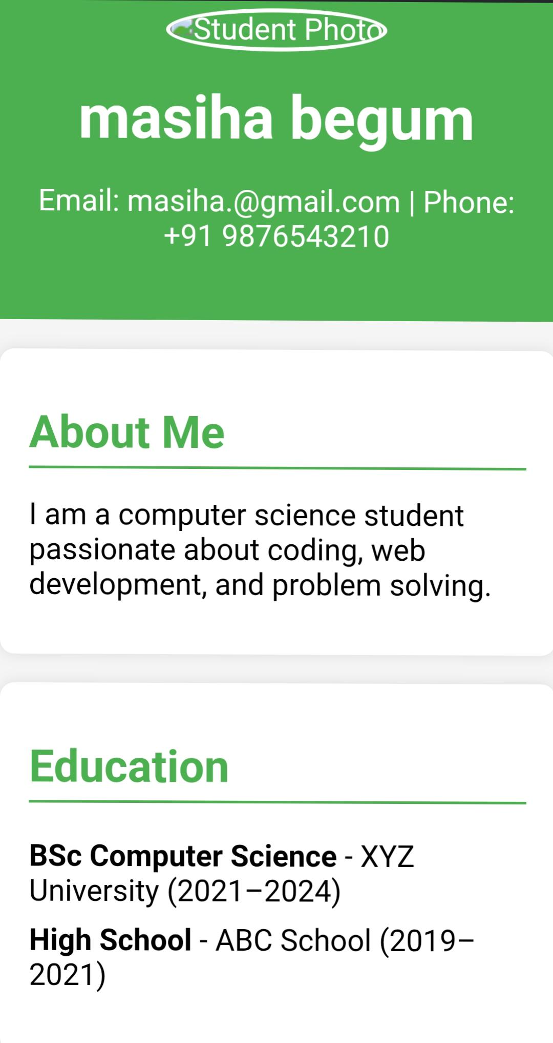
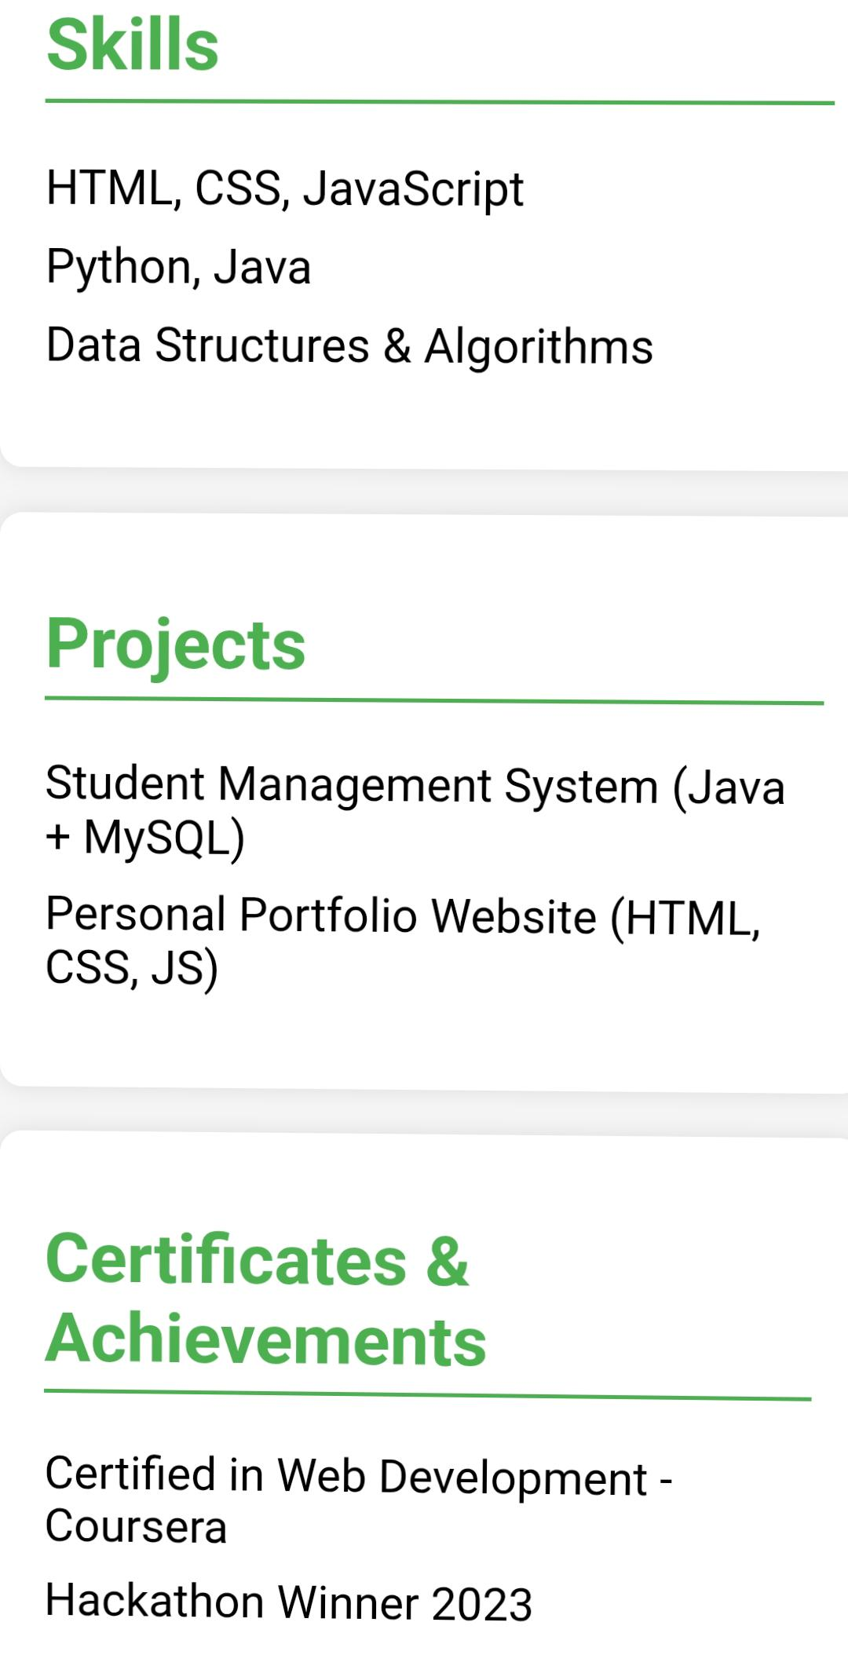
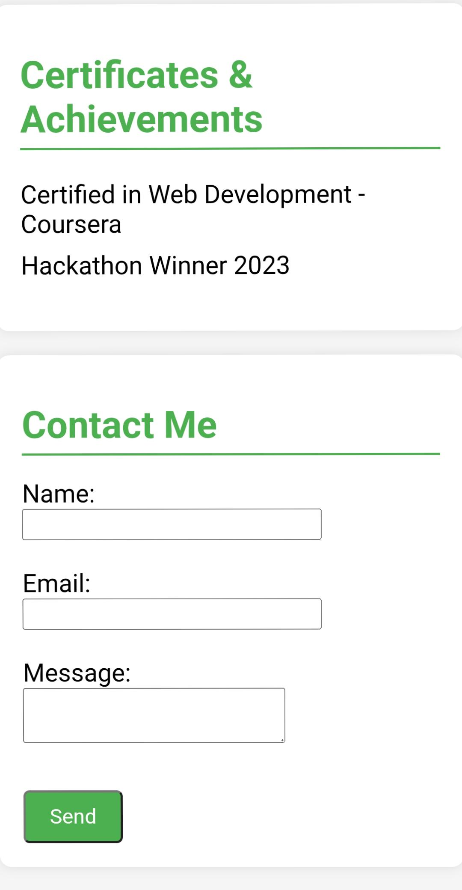
Results and screenshots

Slide 10
Conclusion
A portfolio is an important tool to showcase skills, achievements, and experiences. It reflects personal growth, creativity, and learning. By organizing work in a clear and structured way, a portfolio helps in presenting strengths to teachers, employers, or anyone interested. Overall, it acts as a bridge between knowledge gained and future opportunity

Slide 11
Guthub link
https://github.com/dcca24masiha-a11y/Masiha-begum--TNSDC-FWD-DP.git

